Slide 1

Basic Details of the Team and Problem Statement
Ministry/Organization Name/Student Innovation:
Travel and Tourism/AICTE, MIC-Student Innovation/Student Innovation.
PS Code: SIH1486
Problem Statement Title: A solution/idea that can boost the current situation of the transport and logistics.
Team Name: Techno Mechanus
Team Leader Name: Pranjal Biswas
Institute Code (AISHE): U-0356
Institute Name: Kalinga Institute of industrial Technology
Theme Name: Transportation and Logistics

Slide 2
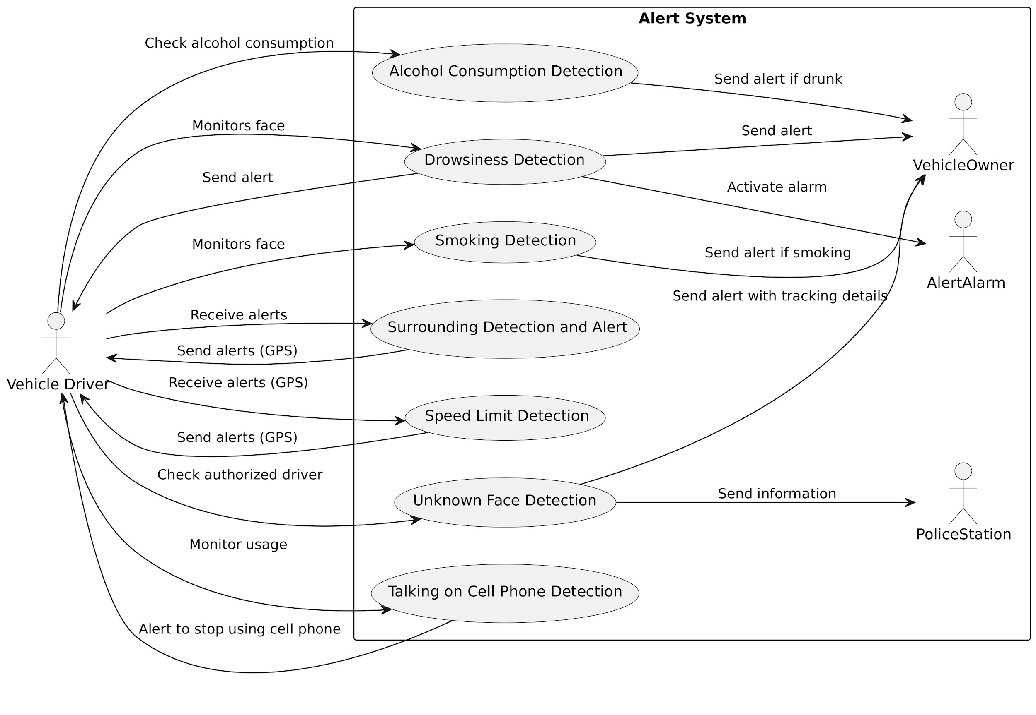
Idea/Approach Details
Describe your idea/Solution/Prototype here:
Objective: of this project is to design, develop, and validate a Driver Alert System (DAS) that can effectively detect and respond to driver-related safety risks, thereby enhancing road safety for both the driver and surrounding road users.
Prototype: The prototype uses MediaPipe Face Detection and the MediaPipe Face Mesh models to calculate the Eye Aspect Ratio in order to judge whether a person is drowsy or not.
Solution: With this project, we are endeavouring to solve the problem of driver alertness and safety. Our project is mainly targeted towards commercial drivers.
Describe your Technology stack here:
Python - general purpose programming language
PyTorch - deep learning framework implemented in Python
OpenCV - computer vision framework implemented in C++ and Python
TorchVision - computer vision library which is a part of PyTorch

Slide 3
Idea/Approach Details
Describe your Use Cases here
Describe your Dependencies / Show stopper here :
The main use cases for our project are listed below-
Ridesharing and Transportation Network Companies (TNCs)
Public Transportation
Logistics and Freight
Smart Cities and Traffic Management
Commercial Fleets in High-Risk Industries
Real-Time Monitoring
Alert Mechanisms
Emergency Response
Enhanced Security
Fleet Management Capabilities
High focus on Driver Safety and Public Safety
Cost-Effective Design

Slide 4
Team Member Details
Team Leader Name: Pranjal Biswas
Branch (Btech/Mtech/PhD etc): Btech Stream (ECE, CSE etc): ECSE Year (I,II,III,IV): III
Team Member 1 Name: Harshit Singhania
Branch (Btech/Mtech/PhD etc): Btech Stream (ECE, CSE etc): CSE Year (I,II,III,IV) III
Team Member 2 Name: Rohan Ganguly
Branch (Btech/Mtech/PhD etc): Btech Stream (ECE, CSE etc): CSE Year (I,II,III,IV): III
Team Member 3 Name: Raj Ratan
Branch (Btech/Mtech/PhD etc):Btech Stream (ECE, CSE etc): CSE Year (I,II,III,IV): III
Team Member 4 Name: Debanshu Saha
Branch (Btech/Mtech/PhD etc): Btech Stream (ECE, CSE etc): CSE Year (I,II,III,IV): III
Team Member 5 Name: Unnati Singh
Branch (Btech/Mtech/PhD etc): Btech Stream (ECE, CSE etc): CSE Year (I,II,III,IV): III

